Slide 1

Lab. training: Embedded Systems Wack-A-Mole 1D
Students:
Pradeep Raghuramprasad
Samar Sh. Ghahfarokhi
Responsible Professor : Professor Dr.-Ing. habil. Armin Zimmermann

Slide 2
Outlines
Wack-A-Mole game
Requirements
Design and Implementation
Circuit Diagram
Performance (Video)

Slide 3

Wack-A-Mole Game

Slide 4
Requirements
Arduino Leonardo Board
Arduino IDE (Software)
Two Servo-motors
Button
LED
Buzzer
Resistors
Breadboard
External Power Supplier

Slide 5
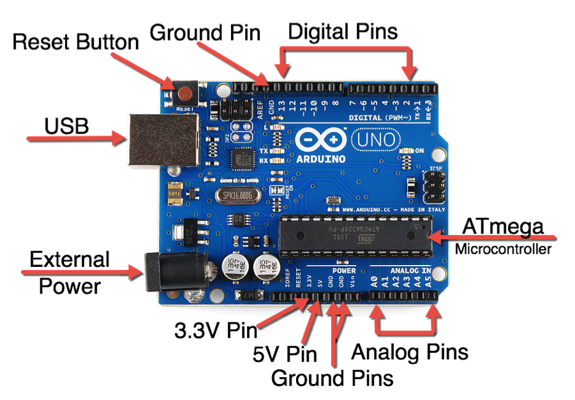
Arduino Microcontroller

Slide 6
Arduino Microcontroller
Open source single board microprocessor to build electronics projects.
Consists of both a physical programmable circuit board (Microcontroller) and a piece of Software IDE (Integrated Development Environment).
Program development based on C

Slide 7
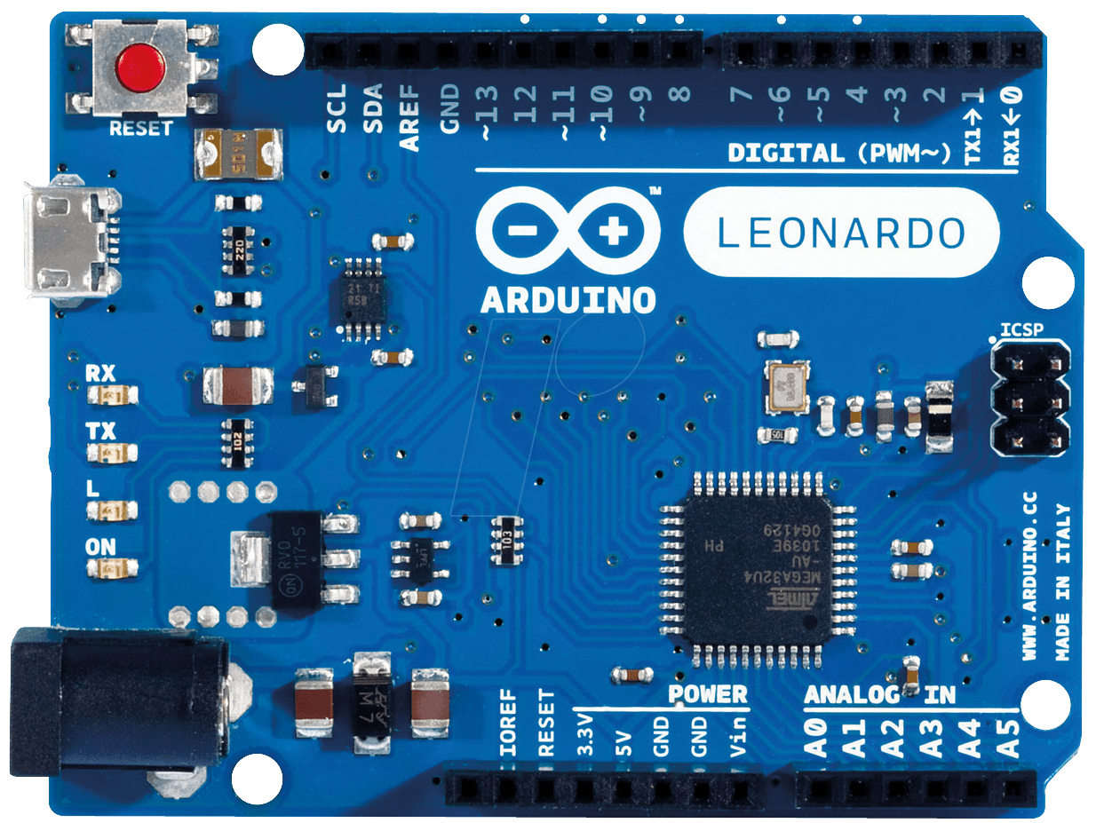
Arduino Leonardo
Compared to the Uno, a slight upgrade.
Built in USB compatibility
Presents to PC as a mouse or keyboard

Slide 8
Game rules
Goal: to push the button when the arm goes up at the right time.
The player has „3“ lives.
By pushing „5“ times correctly (scoring), player is winner.
Advanced to the next level ( higher spped).
„5“ sec after the „game is over“, new game starts.
Buzzer plays sounds for „scoring“, „losing“ and „game over“.

Slide 9
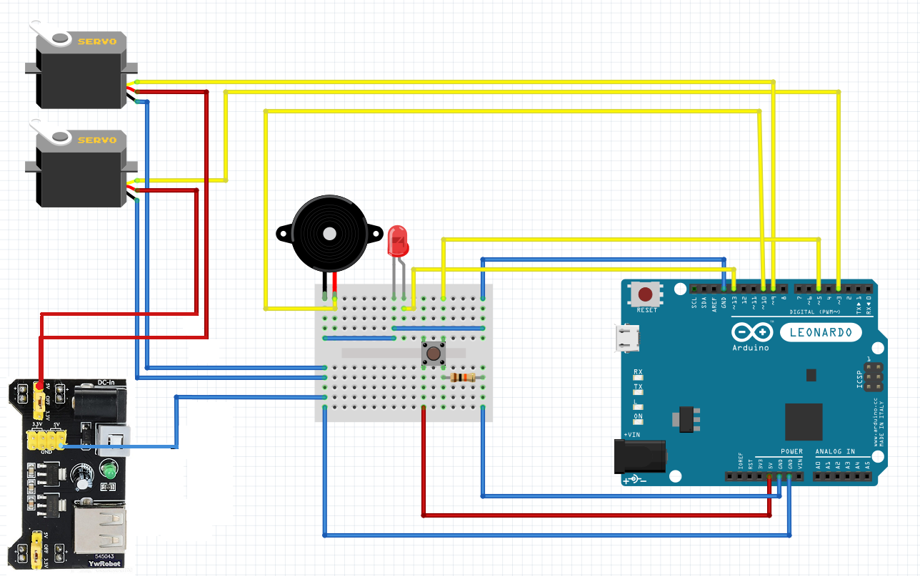
Electronic Circuit

Slide 10
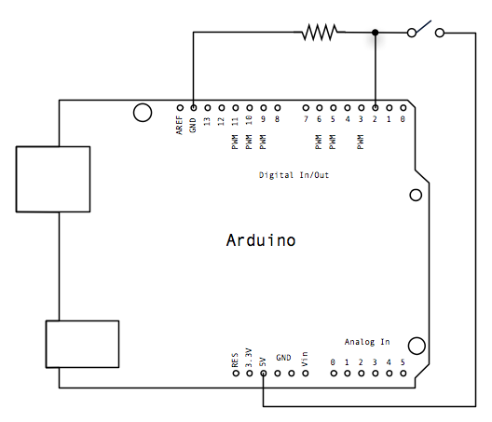
Button Scehmatic

Slide 11
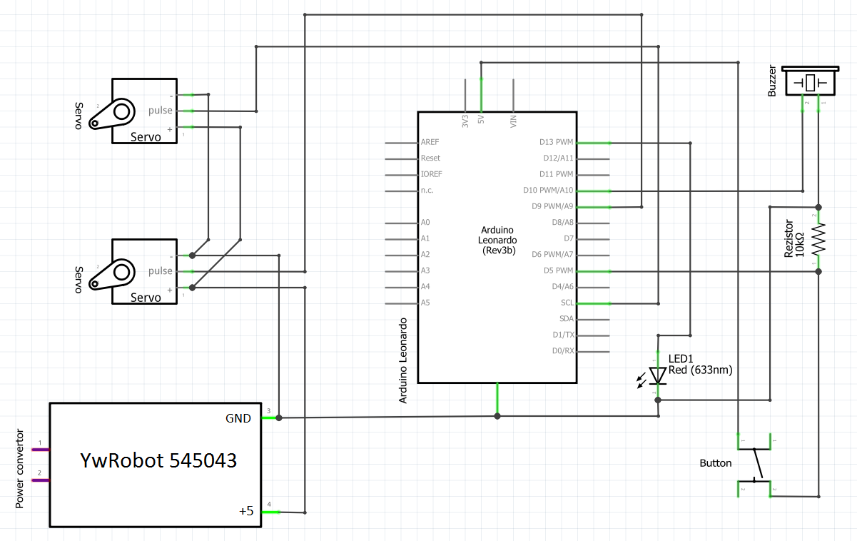
Schematic

Slide 12
Lessons Learned
Space limitation
Debugging skills
Stabilizing Servo Motor (reset due to overload)
Switch (Pull-up resistor)
Organize messy wires
Using delays in programming for expected results

Slide 13
Thank You!

